Slide 1


Data-Intensive Computing with MapReduce
Session 6: Similar Item Detection
Jimmy Lin
University of Maryland
Thursday, February 28, 2013
This work is licensed under a Creative Commons Attribution-Noncommercial-Share Alike 3.0 United States See http://creativecommons.org/licenses/by-nc-sa/3.0/us/ for details

Slide 2
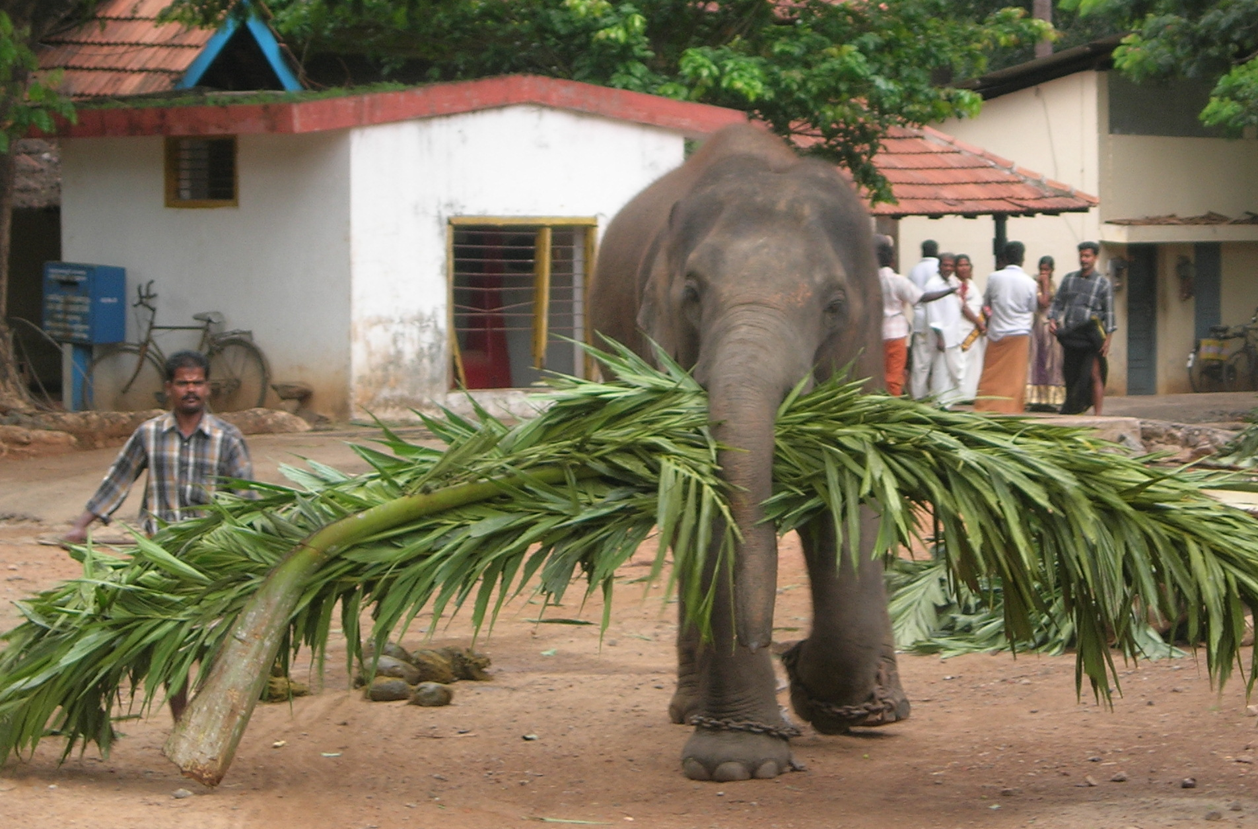
Developing “big data” intuitions…
Source: Wikipedia (Mahout)

Slide 3
Today’s Agenda
The problem of similar item detection
Distances and representations
Minhash
Random projections
End-to-end Wikipedia application

Slide 4
What’s the Problem?
Finding similar items with respect to some distance metric
Two variants of the problem:
Offline: extract all similar pairs of objects from a large collection
Online: is this object similar to something I’ve seen before?
Similarities/differences with the clustering problem

Slide 5
Applications
Near-duplicate detection of webpages
Offline vs. online variant of problem
Recommender systems
Forensic text analysis (e.g., plagiarism detection)

Slide 6
Near-Duplicate Detection of Webpages
What’s the source of the problem?
Mirror pages (legit)
Spam farms (non-legit)
Additional complications (e.g., nav bars)
Naïve algorithm:
Compute cryptographic hash for webpage (e.g., MD5)
Insert hash values into a big hash table
Compute hash for new webpage: collision implies duplicate
What’s the issue?
Intuition:
Hash function needs to be tolerant of minor differences
High similarity implies higher probability of hash collision

Slide 7
Literature Note
Many communities have tackled similar problems:
Theoretical computer science
Information retrieval
Data mining
Databases
…
Issues
Slightly different terminology
Results not easy to compare

Slide 8
Four Steps
Specify distance metric
Jaccard, Euclidean, cosine, etc.
Compute representation
Shingling, tf.idf, etc.
“Project”
Minhash, random projections, etc.
Extract
Bucketing, sliding windows, etc.

Slide 9

Distances
Source: www.flickr.com/photos/thiagoalmeida/250190676/

Slide 10
Distance Metrics
Non-negativity:
Identity:
Symmetry:
Triangle Inequality

Slide 11
Distance: Jaccard
Given two sets A, B
Jaccard similarity:

Slide 12
Distance: Norms
Given:
Euclidean distance (L₂-norm)
Manhattan distance (L₁-norm)
L_{r}-norm

Slide 13
Distance: Cosine
Given:
Idea: measure distance between the vectors
Thus:

Slide 14
Distance: Hamming
Given two bit vectors
Hamming distance: number of elements which differ

Slide 15
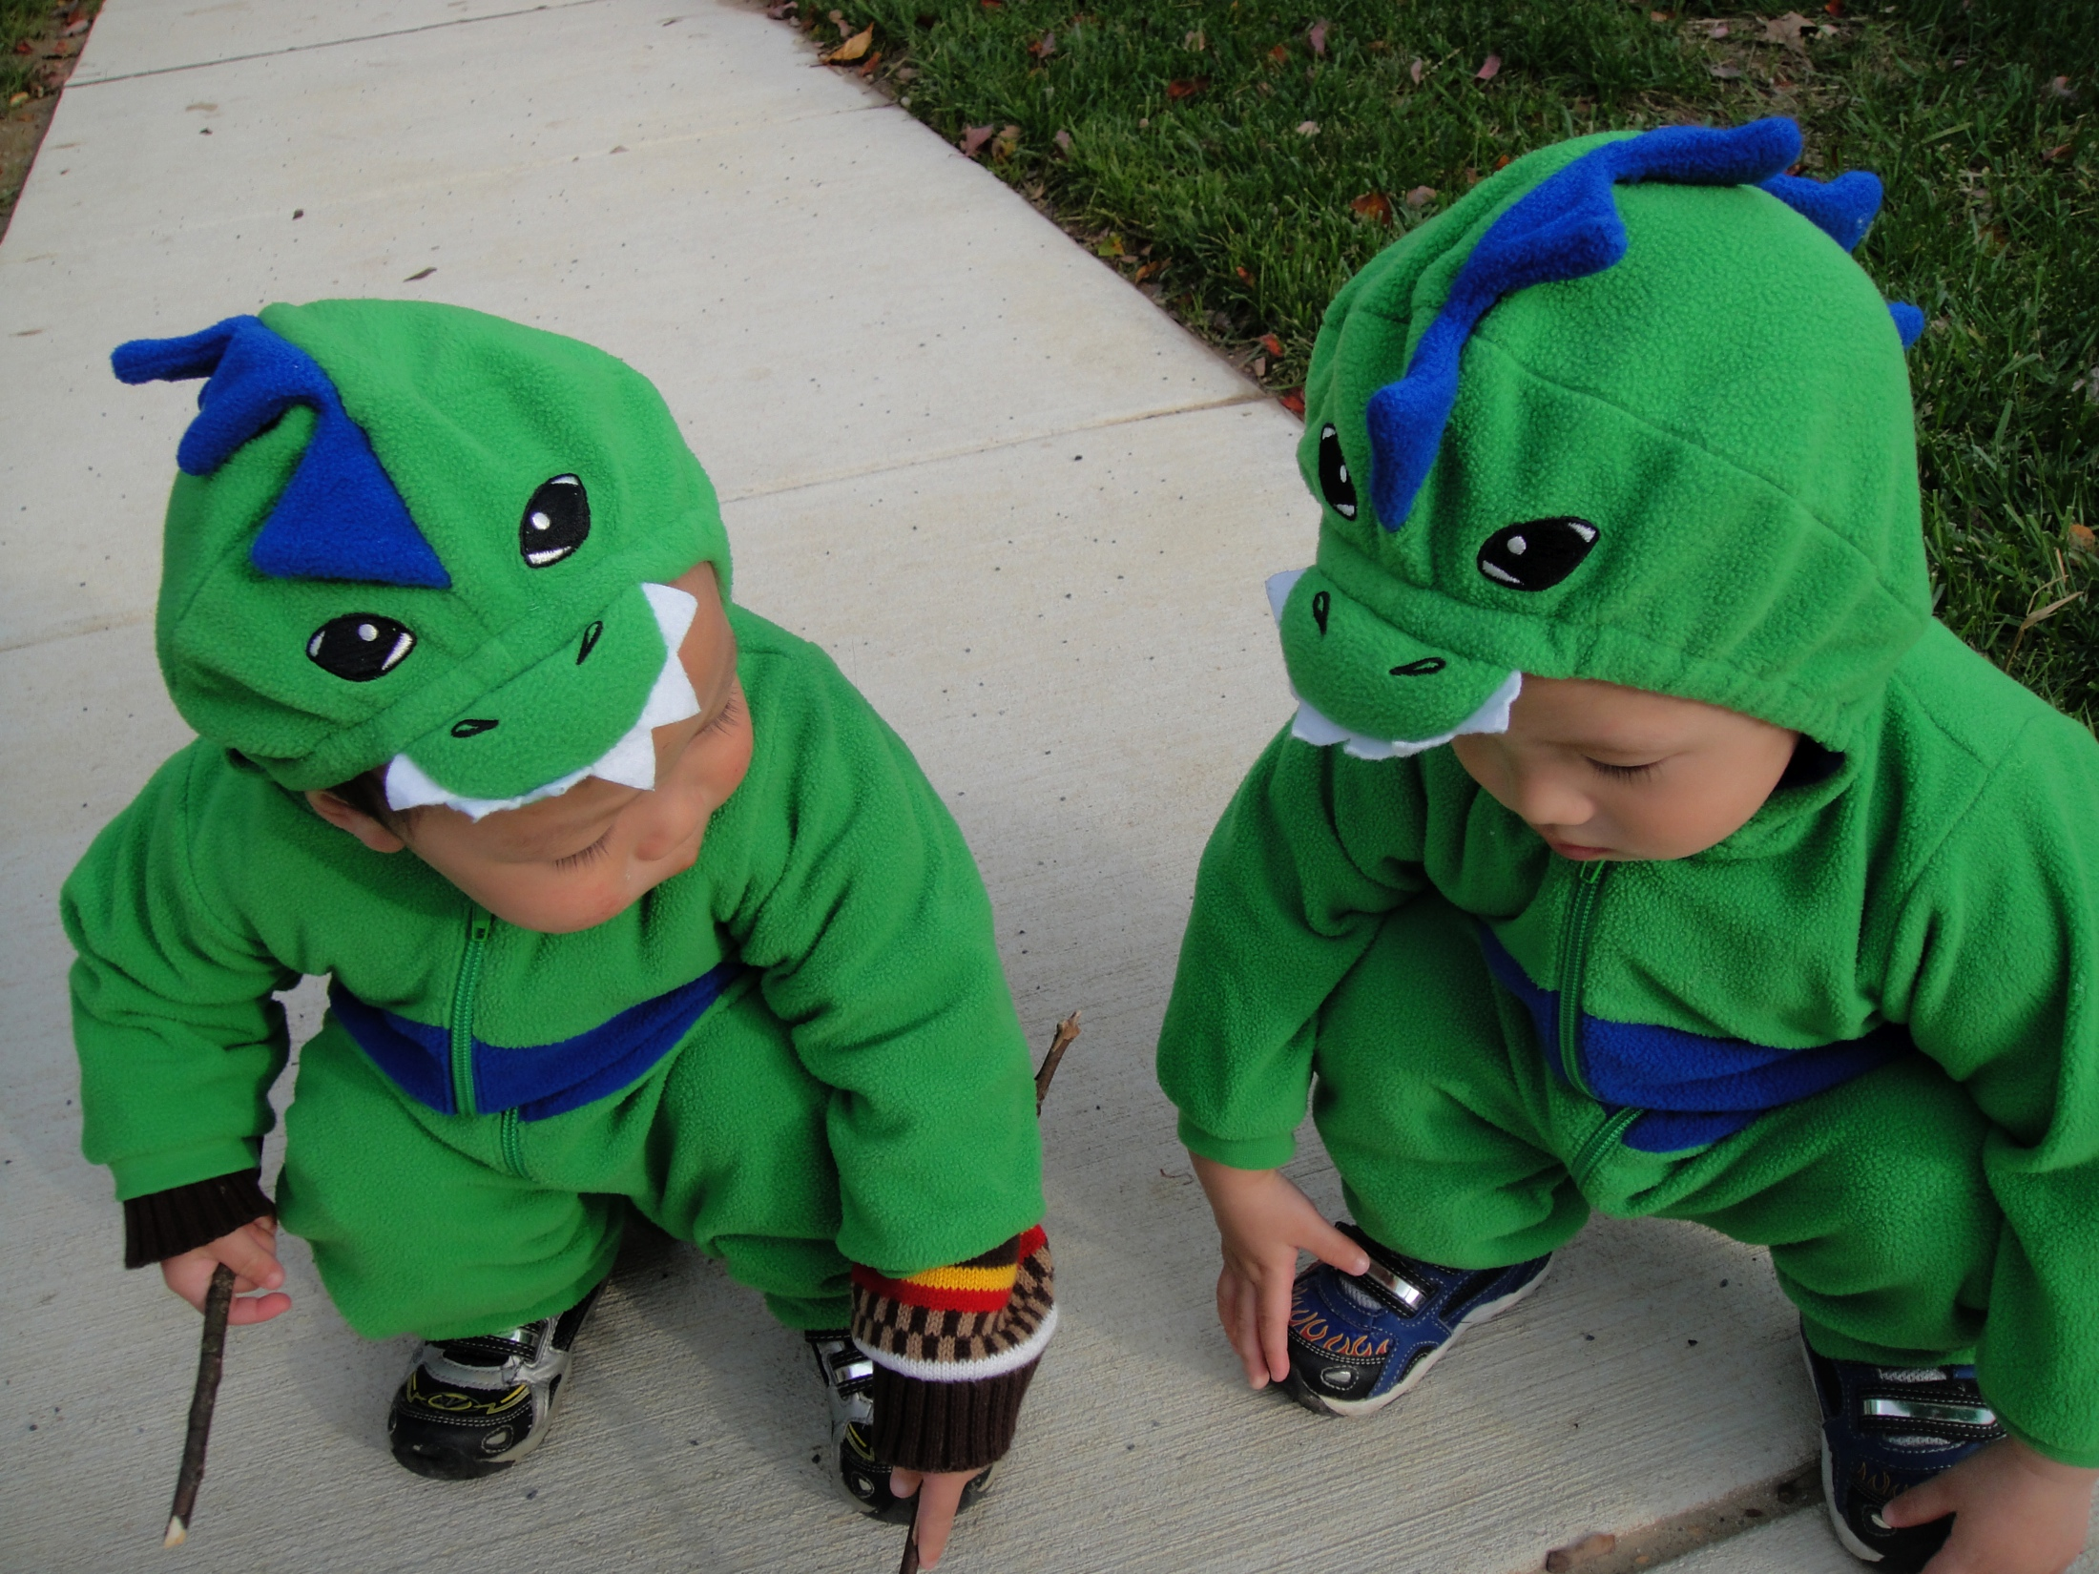
Representations

Slide 16
Representations: Text
Unigrams (i.e., words)
Shingles = n-grams
At the word level
At the character level
Feature weights
boolean
tf.idf
BM25
…
Which representation to use?
What’s the actual text?
Use the hashing trick!

Slide 17
Representations: Beyond Text
For recommender systems:
Items as features for users
Users as features for items
For graphs:
Adjacency lists as features for vertices
With log data:
Behaviors (clicks) as features

Slide 18
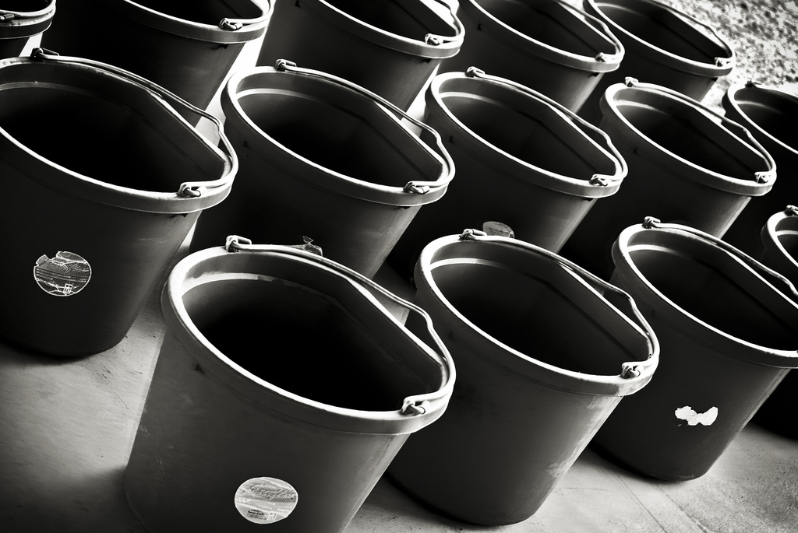
Minhash
Source: www.flickr.com/photos/rheinitz/6158837748/

Slide 19
Minhash
Seminal algorithm for near-duplicate detection of webpages
Used by AltaVista
For details see Broder et al. (1997)
Setup:
Documents (HTML pages) represented by shingles (n-grams)
Jaccard similarity: dups are pairs with high similarity

Slide 20
Preliminaries: Representation
Sets:
A = {e₁, e₃, e₇}
B = {e₃, e₅, e₇}
Can be equivalently expressed as matrices:
Element | A | B
e₁ | 1 | 0
e₂ | 0 | 0
e₃ | 1 | 1
e₄ | 0 | 0
e₅ | 0 | 1
e₆ | 0 | 0
e₇ | 1 | 1

Slide 21
Preliminaries: Jaccard
Element | A | B
e₁ | 1 | 0
e₂ | 0 | 0
e₃ | 1 | 1
e₄ | 0 | 0
e₅ | 0 | 1
e₆ | 0 | 0
e₇ | 1 | 1
Let:
M₀₀ = # rows where both elements are 0
M₁₁ = # rows where both elements are 1
M₀₁ = # rows where A=0, B=1
M₁₀ = # rows where A=1, B=0

Slide 22
Minhash
Computing minhash
Start with the matrix representation of the set
Randomly permute the rows of the matrix
minhash is the first row with a “one”
Example:
h(A) = e₃
h(B) = e₅
Element | A | B
e₁ | 1 | 0
e₂ | 0 | 0
e₃ | 1 | 1
e₄ | 0 | 0
e₅ | 0 | 1
e₆ | 0 | 0
e₇ | 1 | 1
Element | A | B
e₆ | 0 | 0
e₂ | 0 | 0
e₅ | 0 | 1
e₃ | 1 | 1
e₇ | 1 | 1
e₄ | 0 | 0
e₁ | 1 | 0

Slide 23
Minhash and Jaccard
Element | A | B
e₆ | 0 | 0
e₂ | 0 | 0
e₅ | 0 | 1
e₃ | 1 | 1
e₇ | 1 | 1
e₄ | 0 | 0
e₁ | 1 | 0
M₀₀
M₀₀
M₀₁
M₁₁
M₁₁
M₀₀
M₁₀

Slide 24
To Permute or Not to Permute?
Permutations are expensive
Interpret the hash value as the permutation
Only need to keep track of the minimum hash value
Can keep track of multiple minhash values at once

Slide 25
Extracting Similar Pairs (LSH)
We know:
Task: discover all pairs with similarity greater than s
Algorithm:
For each object, compute its minhash value
Group objects by their hash values
Output all pairs within each group
Analysis:
Probability we will discovered all pairs is s
Probability that any pair is invalid is (1 – s)
What’s the fundamental issue?

Slide 26
Two Minhash Signatures
Task: discover all pairs with similarity greater than s
Algorithm:
For each object, compute two minhash values and concatenate together into a signature
Group objects by their signatures
Output all pairs within each group
Analysis:
Probability we will discovered all pairs is s²
Probability that any pair is invalid is (1 – s)²

Slide 27
k Minhash Signatures
Task: discover all pairs with similarity greater than s
Algorithm:
For each object, compute k minhash values and concatenate together into a signature
Group objects by their signatures
Output all pairs within each group
Analysis:
Probability we will discovered all pairs is s^{k}
Probability that any pair is invalid is (1 – s)^{k}
What’s the issue now?

Slide 28
n different k Minhash Signatures
Task: discover all pairs with similarity greater than s
Algorithm:
For each object, compute n sets k minhash values
For each set, concatenate k minhash values together
Within each set:
Group objects by their signatures
Output all pairs within each group
De-dup pairs
Analysis:
Probability we will miss a pair is (1 – s^{k} )^{n}
Probability that any pair is invalid is n(1 – s)^{k}

Slide 29
Practical Notes
In some cases, checking all candidate pairs may be possible
Time cost is small relative to everything else
Easy method to discard false positives
Most common practical implementation:
Generate M minhash values, randomly select k of them n times
Reduces amount of hash computations needed
Determining “authoritative” version is non-trivial

Slide 30
MapReduce Implementation
Map over objects:
Generate M minhash values, randomly select k of them n times
Each draw yields a signature: emit as intermediate key, value is object id
Shuffle/sort:
Reduce:
Receive all object ids with same signature, generate candidate pairs
Okay to buffer in memory?
Second pass to de-dup

Slide 31
Offline Extraction vs. Online Querying
Batch formulation of the problem:
Discover all pairs with similarity greater than s
Useful for post-hoc batch processing of web crawl
Online formulation of the problem:
Given new webpage, is it similar to one I’ve seen before?
Useful for incremental web crawl processing

Slide 32
Online Similarity Querying
Preparing the existing collection:
For each object, compute n sets of k minhash values
For each set, concatenate k minhash values together
Keep each signature in hash table (in memory)
Note: can parallelize across multiple machines
Querying and updating:
For new webpage, compute signatures and check for collisions
Collisions imply duplicate (determine which version to keep)
Update hash tables

Slide 33
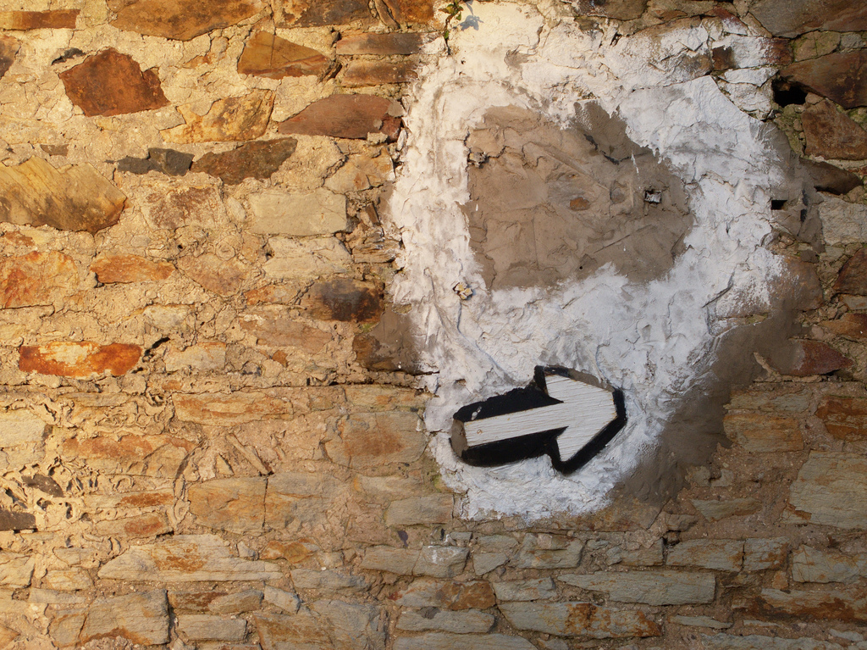
Random Projections
Source: www.flickr.com/photos/roj/4179478228/

Slide 34
Limitations of Minhash
Minhash is great for near-duplicate detection
Set high threshold for Jaccard similarity
Limitations:
Jaccard similarity only
Set-based representation, no way to assign weights to features
Random projections:
Works with arbitrary vectors using cosine similarity
Same basic idea, but details differ
Slower but more accurate: no free lunch!

Slide 35
Random Projection Hashing
Generate a random vector r of unit length
Draw from univariate Gaussian for each component
Normalize length
Define:
Physical intuition?

Slide 36
RP Hash Collisions
It can be shown that:
Proof in (Goemans and Williamson, 1995)
Physical intuition?

Slide 37
Random Projection Signature
Given D random vectors:
Convert each object into a D bit signature
We can derive:
Thus: similarity boils down to comparison of hamming distances between signatures

Slide 38
One-RP Signature
Task: discover all pairs with cosine similarity greater than s
Algorithm:
Compute D-bit RP signature for every object
Take first bit, bucket objects into two sets
Perform brute force pairwise (hamming distance) comparison in each bucket, retain those below hamming distance threshold
Analysis:
Probability we will discover all pairs:
Efficiency:

Slide 39
Two-RP Signature
Task: discover all pairs with cosine similarity greater than s
Algorithm:
Compute D-bit RP signature for every object
Take first two bits, bucket objects into four sets
Perform brute force pairwise (hamming distance) comparison in each bucket, retain those below hamming distance threshold
Analysis:
Probability we will discover all pairs:
Efficiency:

Slide 40
k-RP Signature
Task: discover all pairs with cosine similarity greater than s
Algorithm:
Compute D-bit RP signature for every object
Take first k bits, bucket objects into 2^{k} sets
Perform brute force pairwise (hamming distance) comparison in each bucket, retain those below hamming distance threshold
Analysis:
Probability we will discover all pairs:
Efficiency:

Slide 41
m Sets of k-RP Signature
Task: discover all pairs with cosine similarity greater than s
Algorithm:
Compute D-bit RP signature for every object
Choose m sets of k bits
For each set, use k selected bits to partition objects into 2^{k} sets
Perform brute force pairwise (hamming distance) comparison in each bucket (of each set), retain those below hamming distance threshold
Analysis:
Probability we will discover all pairs:
Efficiency:

Slide 42
Theoretical Results
Threshold = 0.7
What’s interesting here?
Recall
Recall
Number of Random Projections

Slide 43
Online Querying
Preprocessing:
Compute D-bit RP signature for every object
Choose m sets of k bits and use to bucket
Store signatures in memory (across multiple machines)
Querying
Compute D-bit signature of query object, choose m sets of k bits in same way
Perform brute-force scan of correct bucket (in parallel)

Slide 44
Additional Issues to Consider
Emphasis on recall, not precision
Two sources of error:
From LSH
From using hamming distance as proxy for cosine similarity
Balance of bucket sizes?
Parameter tuning?

Slide 45
“Sliding Window” Algorithm
Compute D-bit RP signature for every object
For each object, permute bit signature m times
For each permutation, sort bit signatures
Apply sliding window of width B over sorted
Compute hamming distances of bit signatures within window

Slide 46
MapReduce Implementation
Mapper:
Process each individual object in parallel
Load in random vectors as side data
Compute bit signature
Permute m times, for each emit: key = (n, signature), where n = [ 1 … m ] value = object id
Reduce
Keep FIFO queue of B bit signatures
For each newly-encountered bit signature, compute hamming distance wrt all bit signatures in queue
Add new bit signature to end of queue, displacing oldest

Slide 47
Slightly Faster MapReduce Variant
In reducer, don’t perform hamming distance computations
Write directly to HDFS in large blocks
Perform hamming distance computations in second mapper-only pass
Advantages?

Slide 48

Case Study: Wikipedia
Ture et al., SIGIR 2011
Ture and Lin, NAACL 2012
Source: Wikipedia (Wikipedia)

Slide 49
Mining Bitext from Wikipedia
Task: extract similar article pairs in different languages
Why is this useful?
Why not just use inter-wiki links?
Use LSH!
Why is this non-trivial?

Slide 50
Machine Translation
German
MT
translate
English
Doc A
doc vector v_{A}
English
Doc
B
doc vector v_{B}
Tradeoffs?
“Vector” Translation
German
CLIR translate
Doc A
doc vector v_{A}
doc vector v_{A}
English
Doc
B
doc vector v_{B}

Slide 51
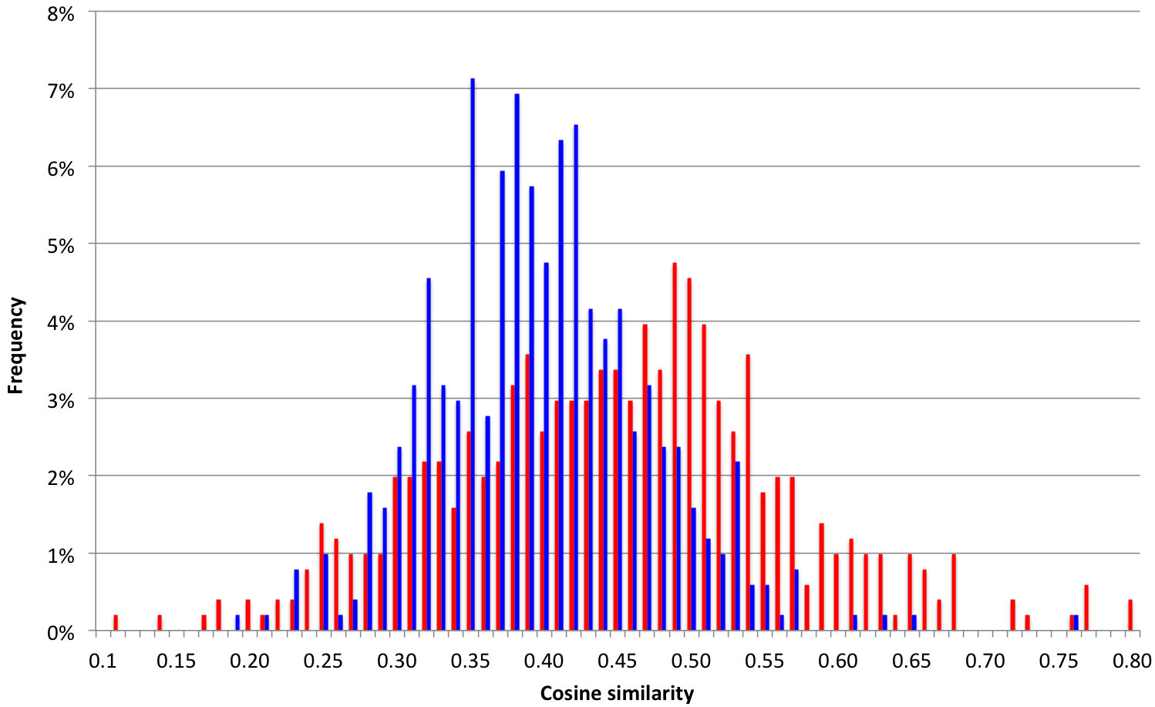
Translations are noisy!
Question: To what extent are “ground truth” mutual translation pairs similar?

Slide 52
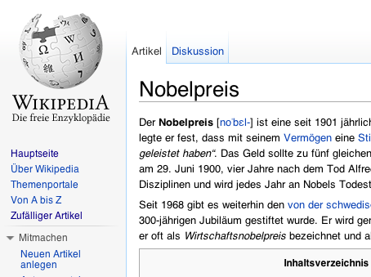
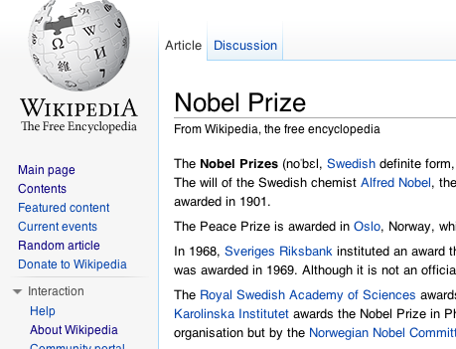
Architecture
German articles
English
articles
Preprocess
document vectors
(English)
Signature generation
Signatures
LSH
Similar article pairs

Slide 53
Evaluation Setup
Collection: 3.44m English + 1.47m German Wikipedia
Brute force: 5.05 trillion comparisons
Task: extract similar documents with cosine similarity > 0.3
Representation: 1000 bit random projections
Ground truth:
Sample ~1000 German Wikipedia articles
Evaluation metrics:
Time
Relative cost
Recall

Slide 54
Results
(16 node cluster)
64 million document pairs

Slide 55
Sources of Error
Hamming distance computation introduces error!
1000-bit random projections yields ~0.04 absolute error
Maximum obtainable recall is 0.76
Why not just compute cosine similarity?
20 times slower than computing hamming distance
Let’s renormalize with respect to hamming distance upper bound…

Slide 56
No Free Lunch!
99% recall
70% cost
95% recall
39% cost

Slide 57
No Free Lunch!
100% recall? Don’t use LSH!
99% recall
70% cost
99% recall
62% cost
95% recall
39% cost

Slide 58
Parallel Sentence Extraction
Model parallel sentence extraction as a classification problem
Given a candidate pair, classify as “parallel” or “not parallel”
What’s the problem?
64m document pairs yields 400b raw sentence pairs
What’s that quote about premature optimization?

Slide 59
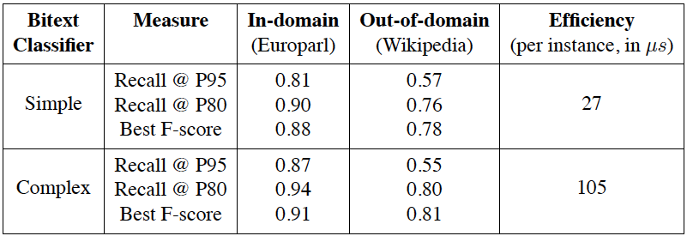
Two-Step Classification
Approach:
Apply a few simple heuristics
“Simple” classifier: efficiently filters out irrelevant pairs
“Complex” classifier: effectively classifies remaining pairs

Slide 60
Join
Algorithm 1
Mapper processes both English and foreign collection
Load all (d_{e}, d_{f}) similarity pairs in memory as side data
When encountering relevant document, emit (d_{e}, d_{f}) pair as key, list of sentence vectors as value
Reducer:
Gather sentence vectors, compute Cartesian product and apply classifier
Algorithm 2
Same idea as first, except with stripes pattern
Which is faster?

Slide 61
Complete Pipeline
source
collection F
Phase 1
doc vectors_{F}
Preprocess
Signature Generation
signatures_{F}
Sliding Window
Algorithm
target
collection E
doc vectors_{E}
Preprocess
Signature Generation
signatures_{E}
cross-lingual
document pairs
Phase 2
candidate
sentence pairs
aligned bilingual
sentence pairs
2-step Parallel Sentence Classifier
Candidate Generation

Slide 62
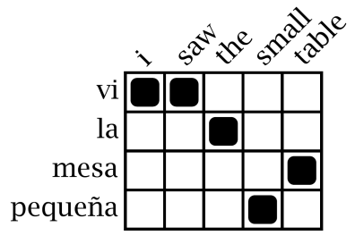
Statistical Machine Translation
Word Alignment
Phrase Extraction
Training Data
i saw the small table
(vi, i saw)
(la mesa pequeña, the small table)
…
vi la mesa pequeña
Parallel Sentences
he sat at the table
the service was good
Language Model
Translation Model
Target-Language Text
Decoder
maria no daba una bofetada a la bruja verde
mary did not slap the green witch
Foreign Input Sentence
English Output Sentence

Slide 63
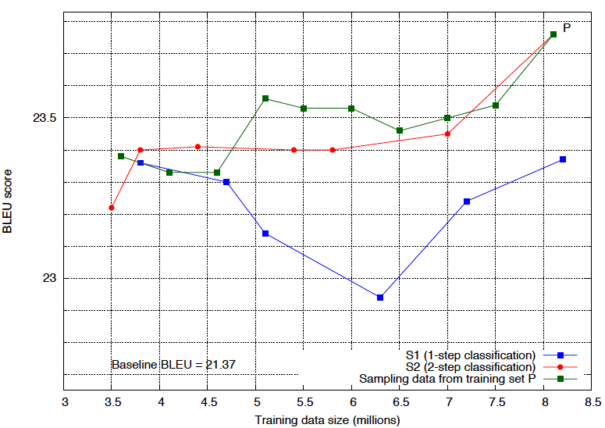
Evaluation

Slide 64
Today’s Agenda
The problem of similar item detection
Distances and representations
Minhash
Random projections
End-to-end Wikipedia application

Slide 65

Questions?
Source: Wikipedia (Japanese rock garden)

